Slide 1

Computational Biology SILAC
Stable Isotope Labeling by Amino acids in Cell culture
Prof. Dr. Ibrahim Al-Awadi
Eng. Ghada Samir

Slide 2



SILAC:
Stable Isotope Labeling by/with Amino acids in Cell culture.
SILAC is a power method based on mass spectrometry that identifies and quantifies relative differential changes in protein abundance.
First used in quantitative proteomics in 2002, it provides accurate relative quantification without any chemical derivatization or manipulation.

Slide 3
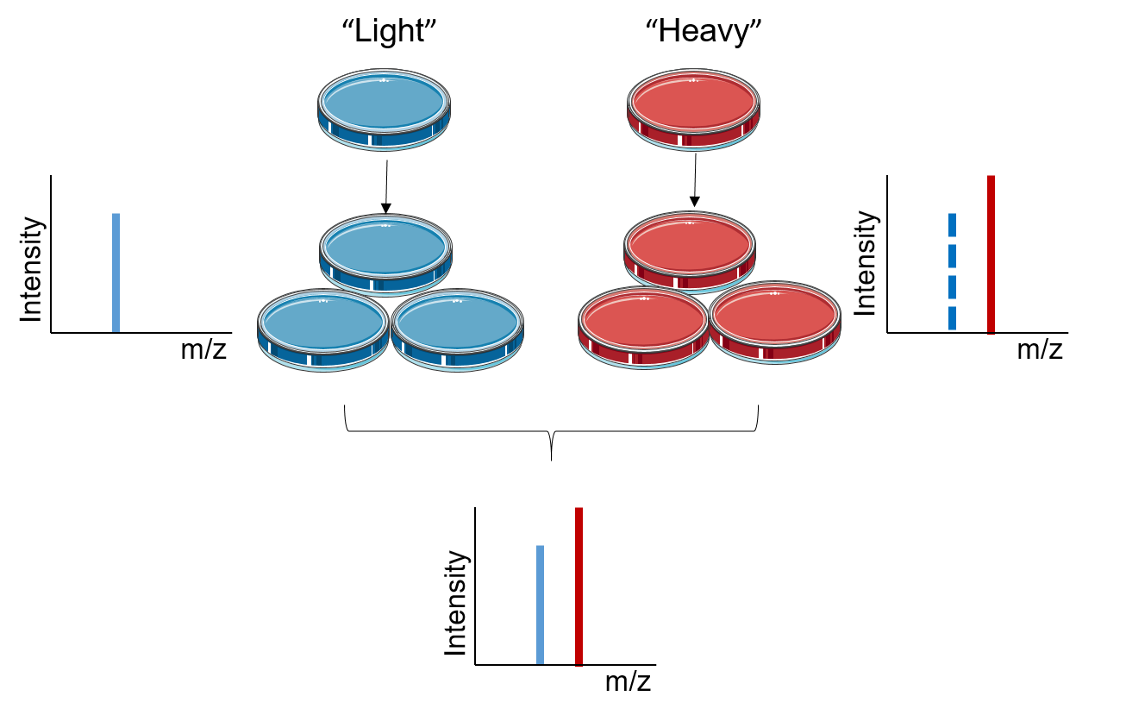
The principle of SILAC:
The principle of SILAC is based on metabolically incorporating stable isotope labeled amino acids into the entire proteome.
The “Light” medium that contains amino acids with the natural isotope and the “ Heavy” medium that contains stable isotope labeled amino acids.

Slide 4
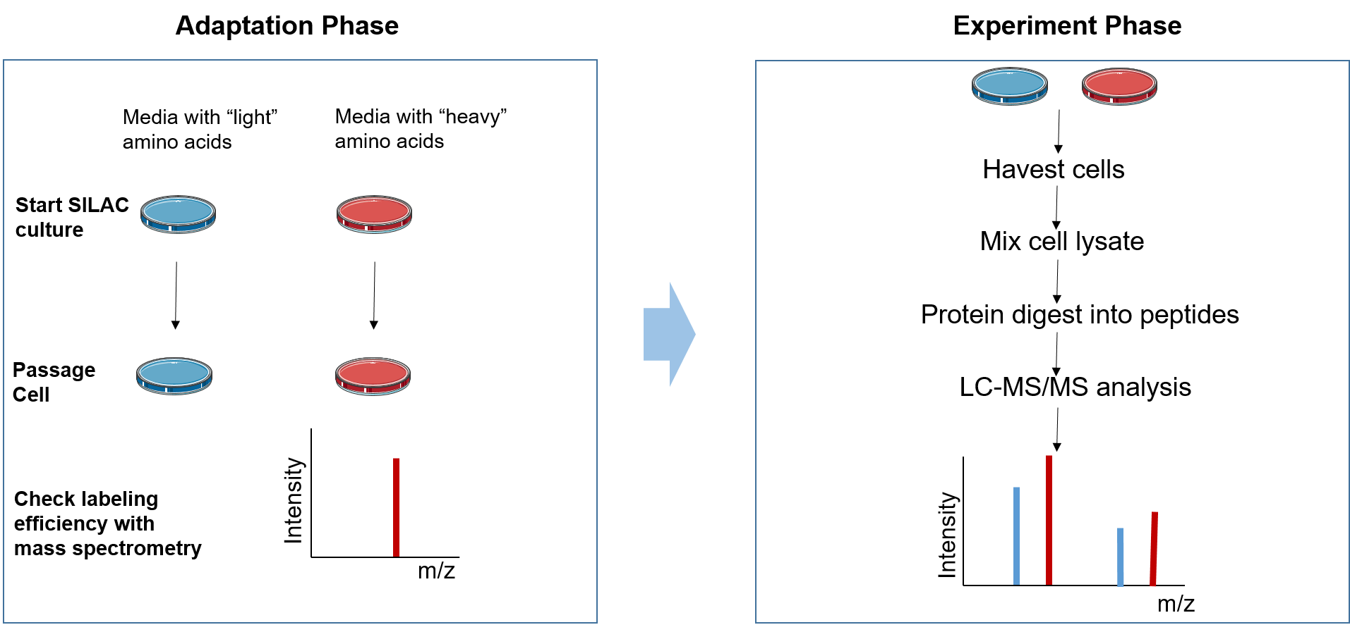
Workflow of SILAC:
The SILAC experiment can be divided into two phases :
The adaptation phase.
The experimental phase.

Slide 5
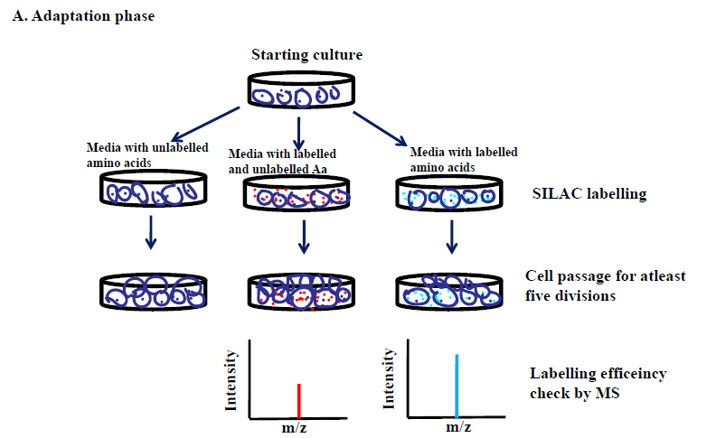
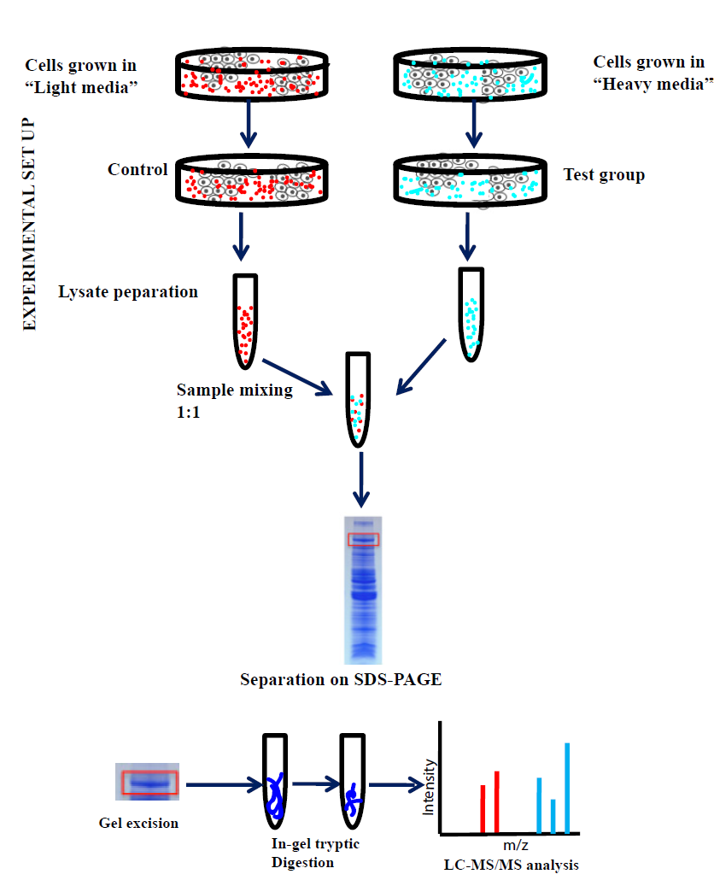
The adaptation phase.
The experimental phase.

Slide 6
Advantages of SILAC-based Proteomics:
High labeling rate: The labeling efficiency is not affected by lysate and efficiency can be as high as 100%.
High sensitivity: The sample requirements are small, usually only tens of micrograms of protein per sample.
High throughput: Mass spectrometry can identify and quantify hundreds to thousands of proteins simultaneously.
High precision: Multiple samples are mixed, simultaneously digested, and identified. The subsequent experiments have the same effect on the sample, which reduces the impact of experimental operation and equipment, and has higher precision and reproducibility.
High activity: The label uses in vivo labeling technology and is closer to the true state of the sample.
Comprehensive services: Combined with other technologies, we can provide protein-protein interaction and post-translational modification analysis.

Slide 7
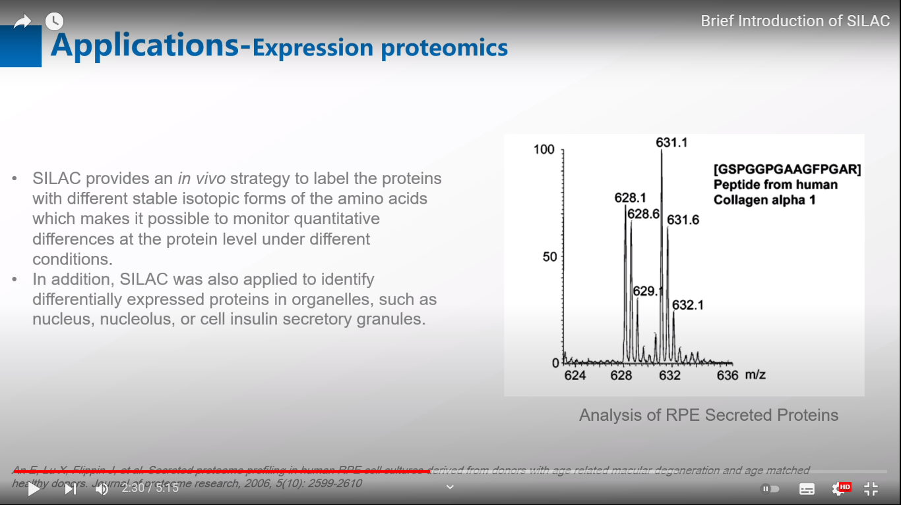
Applications:
1. Expression proteomics
SILAC provides an in vivo strategy to label the proteins with different stable isotopic forms of the amino acids which makes it possible to monitor quantitative differences at the protein level under different conditions

Slide 8
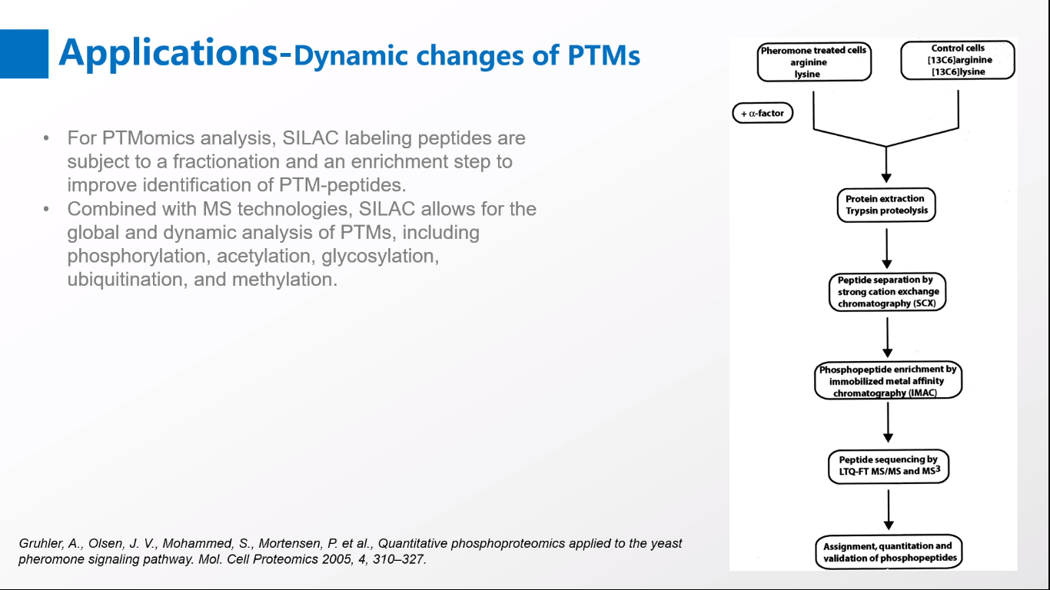
2. Dynamic changes of PTMs:
For PTMomics analysis, SILAC labeling peptides are subject to a fractionation and an enrichment step to improve identification of PTM-peptides.
Combined with MS technologies ,SILAC allows for the global and dynamic analysis of PTMs , including phosphorylation , acetylation ,glycosylation , ubiquitination ,and methylation.

Slide 9
Thank You
Made By :
Gehad Badr (section 3)
Dina Mohamed Sayed (section 3)
Dina Mahmoud lbrahim(section 3)
Rahma Ahmed Shaban(section 3)
Selvia Nagy(section 4)
Sandy Adel(section 4)

